Slide 1
Linear Regression

Slide 2
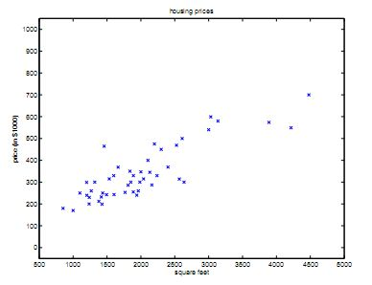
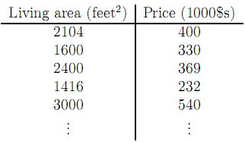
An example
Given Data of houses of a particular area (Portland, Oregon)
Can we predict the price given the living area of a house ?

Slide 3
Supervised Learning
Based on the input-output relation or output value availability, learning can be
Supervised
Unsupervised
Semi-supervised

Slide 4
Supervised Learning
The goal of supervised learning
Given a training set, the goal is to learn a function
h : X→Y
h(x) or simply h should be a good predictor for the corresponding value of y
h is called a hypothesis

Slide 5
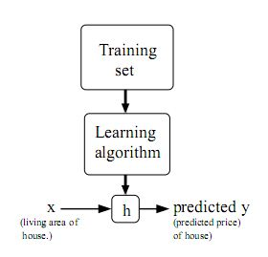
Supervised Learning
Hypothesis Space

Slide 6
Regression and Classification
Target/Output variable type
if Continuous, then Regression
If Discrete, then Classification

Slide 7
Regression
Input variable/Feature Count
If feature variable count == 1, then it is Simple Regression
Linear Regression
Non-linear Regression
If feature variable count > 1, the Multiple Regression
Linear Regression
Non-linear Regression

Slide 8
Regression
What will be price for the living area 220 ?
4K
y
3K
2K
Price
1K
100
200
300
400
500
x
Living Area

Slide 9
If we can represent the training data with a representative line, then it will be easier for us to predict
4K
y
3K
2K
Price
1K
100
200
300
400
500
x
Living Area

Slide 10
A straight line is a hypothesis h_{θ}(x)=θ₀+ θ₁x
4K
3K
The green line has a certain value of θ₀ and θ₁
y
2K
Price
The violet line is a different straight line and so different hypothesis having different value of θ₀ and θ₁
1K
100
200
300
400
500
x
Living Area

Slide 11
Different Lines
So for single attribute x (simple linear regression)
h_{θ}(x) = θ₀
h_{θ}(x) = θ₀+ θ₁x
h_{θ}(x) = θ₀+ θ₁x+ θ₂x²
4K
y
3K
2K
Price
1K
100
200
300
400
500
x
Living Area

Slide 12

General Hypothesis Form
We are considering here h_{θ}(x) = θ₀+ θ₁x
x is the input feature vector
x can have multiple attributes/features/input variables
x= x₁,x₂,…, x_{n}
We can use h(x) instead of h_{θ}(x)
h(x) = θ₀+ θ₁x₁+ θ₂x₂+…+ θ_{n}x_{n}
= θ₀x₀ + θ₁x₁+ θ₂x₂+…+ θ_{n}x_{n} [x₀ is 1 ]

Slide 13

Cost Function
Now, the task is to find the best hypothesis (best possible combination of θ’s )
A heuristic:
‘Best’ is the one which gives smallest error on the training data
J(θ) is the cost function
The goal is to minimize the J(θ)

Slide 14
Minimizing Cost function
For simplicity, we consider θ = θ₀ only
Now plot, J(θ) against θ (= θ₀)
4K
4
y
3K
J(θ)
3
2K
2
Price
1K
1
100
200
300
400
500
1
2
3
4
5
x
θ₀
Living Area

Slide 15
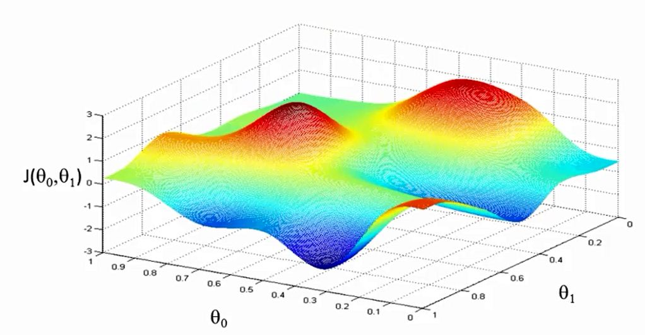
Gradient Descent
Non-Convex shape – Problematic to find the global minimum

Slide 16
Gradient Descent
Convex shape – Easier to find the global minimum

Slide 17
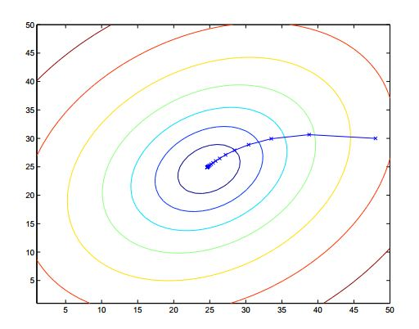
Gradient Descent

Slide 18
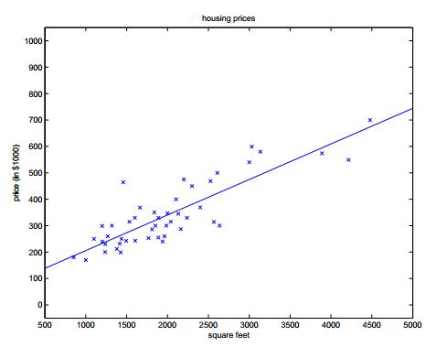
Gradient Descent
4K
y
3K
2K
Price
1K
100
200
300
400
500
x
Living Area

Slide 19

Gradient Descent
Update rule
α is the learning rate
j is input dimension

Slide 20





For single training data point

Slide 21


So for a single training example, the update rule
This rule is called LMS (Least Mean Squares) update rule
Also know as Widrow-Hoff update rule

Slide 22
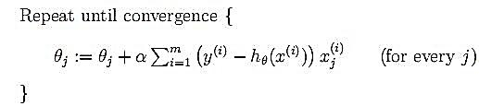
Batch Gradient Descent
Considers all the training examples at a time during a single update step

Slide 23
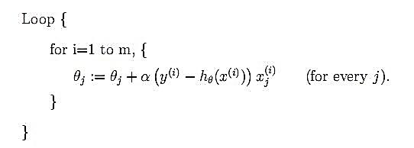
Incremental Gradient Descent
The parameters are updated for immediately for every single training example
Also known as Stochastic Gradient Descent
Batch vs Incremental

Slide 24
References
CS229 Lecture Notes by Andrew Ng

Slide 25
Thank you ☺

